Slide 1





HackOrbit 2025
Akatsuki

Slide 2

DOMAIN- ARTIFICIAL INTELLIGENCE AND MACHINE LEARNING
PROBLEM STATEMENT-
Uncontrolled forest fires increasingly threaten ecosystems, air quality, and communities, yet real-time forecasting remains a major challenge. Fire spread depends on a complex mix of weather, terrain, vegetation, and human presence. Despite rich geospatial data from sources like FSI and VIIRS-SNP, current methods fail to leverage it effectively for timely, predictive action—leaving a critical gap in wildfire response.

Slide 3
PROPOSED SOLUTION
Data Ingestion & Prep:
Fetch daily LULC, 30 m DEM, meteorological rasters (wind, rain, temperature, humidity) and thematic layers (fuel indices, roads/settlements).
Resample and align all inputs to a 30 m grid.
Feature Stacking & Modeling:
Create multi‑band feature cubes; normalize continuous variables and encode fuel classes.
Train a U‑Net (or LSTM‑augmented) model on historical VIIRS hotspots to output per‑pixel fire/no‑fire probabilities.
Spread Simulation:
Use a cellular automaton driven by local risk scores, wind vectors, slope and fuel load.
Iterate to produce 1 h, 3 h, 6 h and 12 h spread maps.
Delivery & Validation:
Expose REST APIs and a simple web dashboard (Leaflet) for heatmaps and time‑lapse playback.
Validate against recorded fire perimeters; refine CA rules and model thresholds.

Slide 4
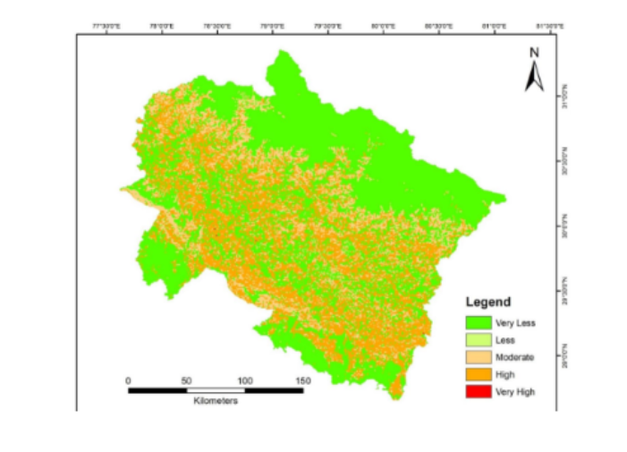
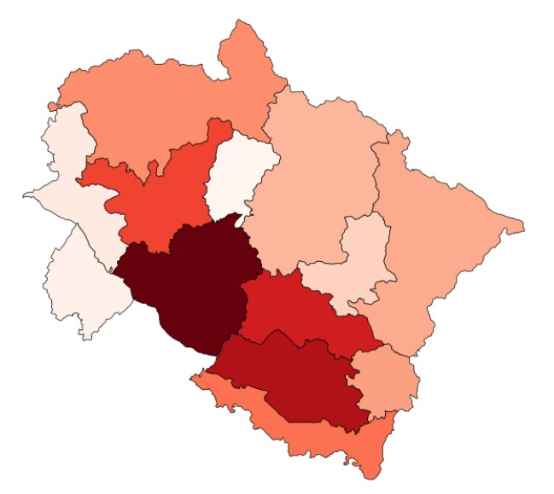
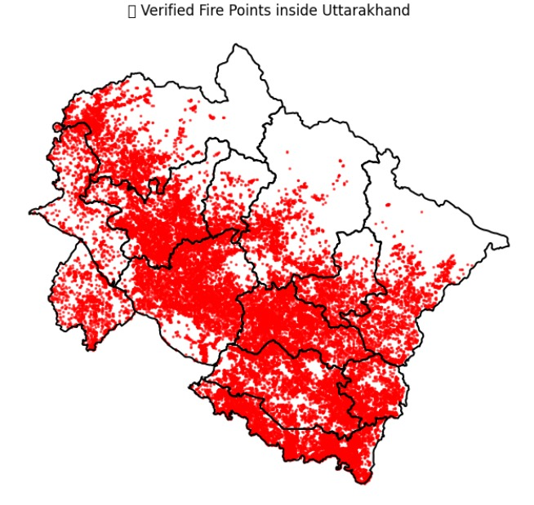
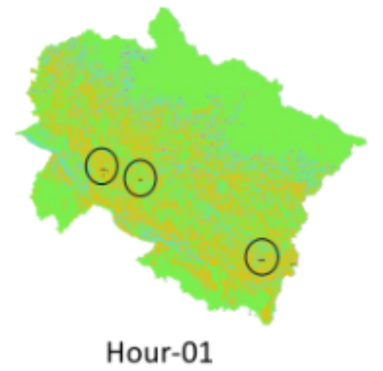

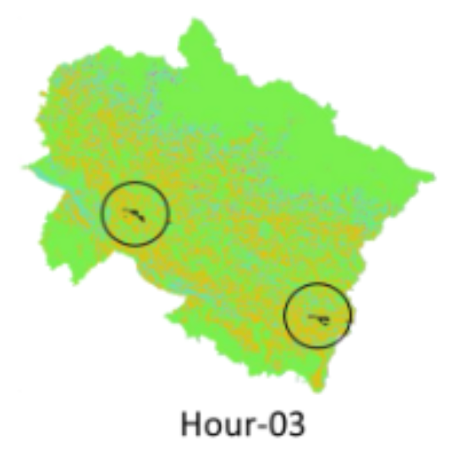
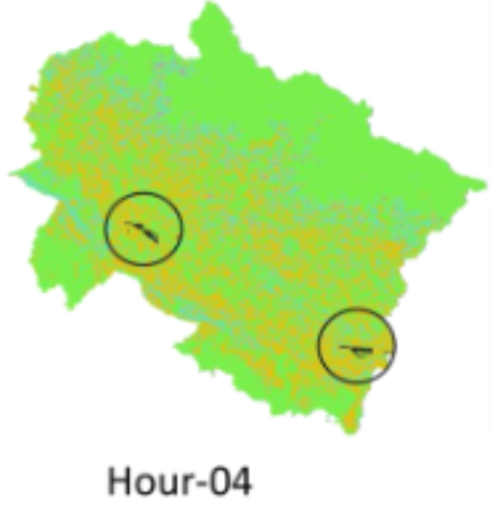
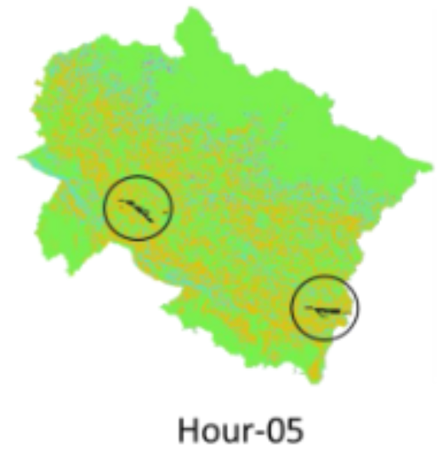
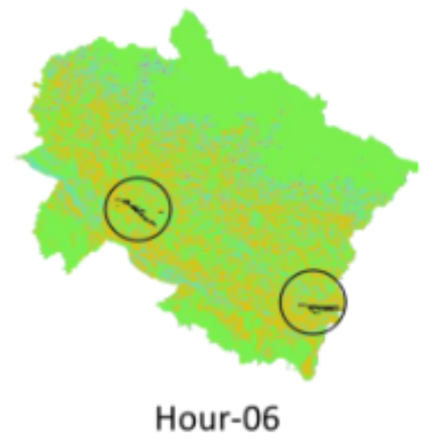
FLOWCHART / DIAGRAM

Slide 5
FLOWCHART / DIAGRAM
Base Map: The map of Uttarakhand is shaded from green (very low risk) through yellow and orange to red (very high risk).
Interpretation: Areas in red/orange are most likely to ignite within the next 24 hours, based on fused inputs like vegetation fuel, slope, and recent weather. Vast tracts in green indicate minimal fire probability.
HOUR | PROPOGATION
HOUR 1 | Initial ignition points (circled) begin to expand outward along prevailing slopes.
HOUR 2 | Fire fronts creep further, especially downhill and in wind‑favored corridors.
HOUR 3 | Several new patches ignite as embers jump ridges (arrows).
HOUR 4 | Spread accelerates through contiguous fuel pockets; arrows mark dominant growth directions.
HOUR 5 | Separate fire clusters merge, forming larger burning zones.
HOUR 6 | The perimeter has doubled from the start, highlighting fastest spread axes (circled arrows).

Slide 6
FEATURES
30 m Multi‑Source Fusion: Daily ingestion of satellite hotspots, weather rasters, DEM (slope/aspect), fuel–cover and human‑activity layers into a unified grid.
Deep‑Learning Classifier: U‑Net/LSTM model produces crisp per‑pixel fire/no‑fire maps for next‑day forecasting.
Hybrid Spread Engine: Cellular automaton driven by learned risk scores, wind, slope and fuel to simulate 1 h–12 h fire fronts.
API & Dashboard: GeoTIFF outputs and a React/Leaflet interface for time‑lapse visualization and quick decision support.
NOVELTY
CNN + CA Integration: Merges data‑driven ignition probabilities with process‑based spread rules.
Fine‑Scale, Rapid Updates: 30 m resolution maps refreshed daily—uncommon in wildfire tools.
Anthropogenic Layering: Roads and settlements explicitly factored into risk assessment.
Feedback‑Loop Validation: Automated perimeter checks refine both classifier thresholds and CA
transitions.

Slide 7
DRAWBACK AND SHOWSTOPPERS
Data Delays: Missing or lagging satellite/weather feeds stall the pipeline.
Compute Intensive: 30 m CNN inference + CA simulations demand GPU clusters.
Simplified Physics: Cellular automaton can’t capture all fire–atmosphere dynamics.
Generalization Risk: Unseen weather extremes or fuel conditions may yield poor forecasts.
Feed Outages: Loss of IMD/ERA‑5 or Sentinel access halts end‑to‑end flow.
Validation Gaps: No recent fire‑perimeter data prevents meaningful tuning.
Hardware Limits: Lack of GPUs or edge compute makes daily runs infeasible.
Data Licensing: Restricted access to key datasets blocks full deployment.

Slide 8
Akatsuki
SUYASH KHARE +91 70002 88575 MITS GWALIOR Machine Learning
NIKHIL BIDHA +91 7974513789 MITS GWALIOR Data Analysis
SHASHWAT VERMA +91 83035 45027 MITS GWALIOR Frontend
NAMAN PRASAD +91 78793 70993 IIIT JABALPUR Backend

Slide 9
Thank you

